Slide 1
Python
Control Flow 1

Slide 2


Control flow in python
You see a apple seller
Decision making is required when we want to execute a code only if a certain condition is satisfied.
Do u like
You don’t purchase apple
You purchase 2 kg apples

Slide 3
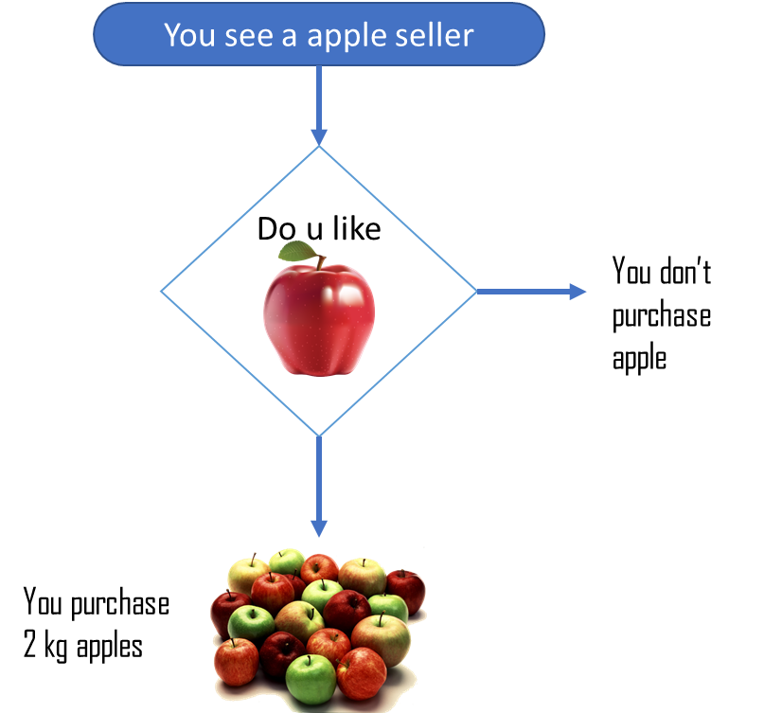
Control flow in python
Decision making is required when we want to execute a code only if a certain condition is satisfied.
As you will see, we can also write the diagrammatic representation in English
You see a apple seller
Do u like apples
If yes
you purchase 2 kg apples
If no
you don’t purchase apple

Slide 4
Control flow in python
Decision making is required when we want to execute a code only if a certain condition is satisfied.
You see a apple seller
Do u like apples
Making a choice
If yes
condition
In real life, we have to say some words
to specify what is a condition and what action we are going to take.
you purchase 2 kg apples
action
If no
condition
if
while
when
you don’t purchase apple
action
else
अगर
मगर

Slide 5
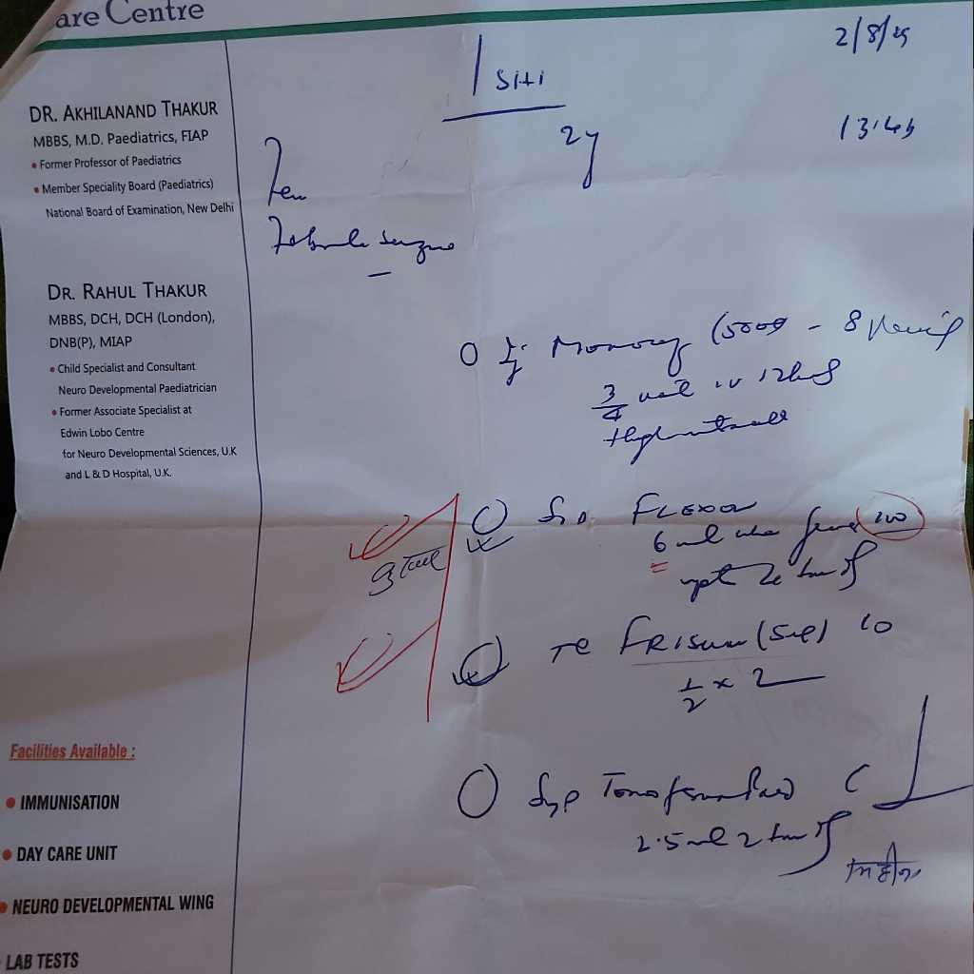
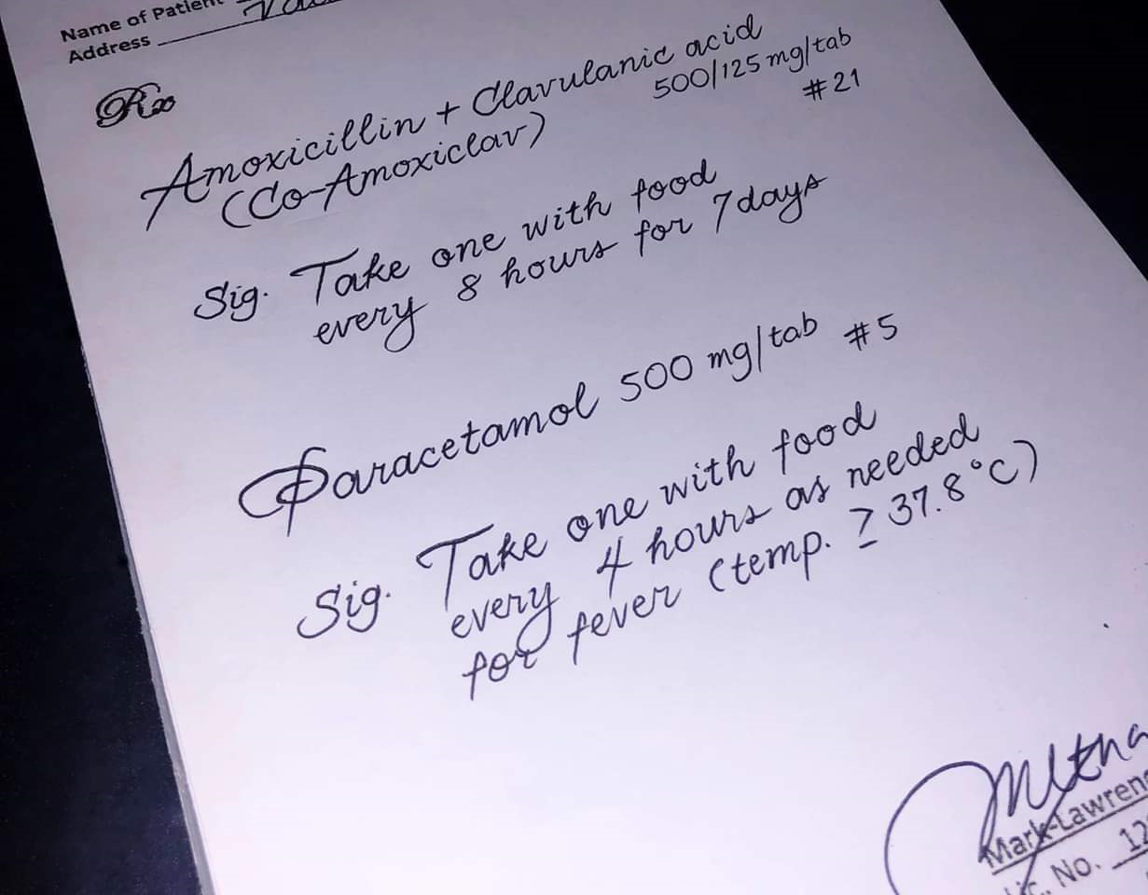
Coding Style – how to write
Which one do you understand
*No doctors/patients were harmed during this process

Slide 6
Coding Style – how to write
Code Style /formatting
It gets difficult to understand a messed up handwriting, similarly an unreadable and unstructured code is not accepted.
You see a apple seller
Do u like apples
The coding style in python is called PEP 8 (Python Enhancement Proposal)
If yes
condition
you purchase 2 kg apples
action
PEP 8 adds a logical meaning to your code. Some key terms that we are going to use are
If no
condition
Indentation
Variable naming
you don’t purchase apple
spacing
commenting
action

Slide 7
Coding Style – how to write
Blocks and indentation
program
Block are group of code lines for building logic in code. A block will have a starting and ending.
You see a apple seller
The first line of block is aligned to previous line (statement), while the following lines of the block are indented inside it
Do u like apples
If yes
statement
condition
Indentation is created by giving 4 spaces to each line inside a block. And to tell python the block is end, we remove the indent
you purchase 2 kg apples
indent
action
block
If no
condition
you don’t purchase apple
indent
action
indentation

Slide 8
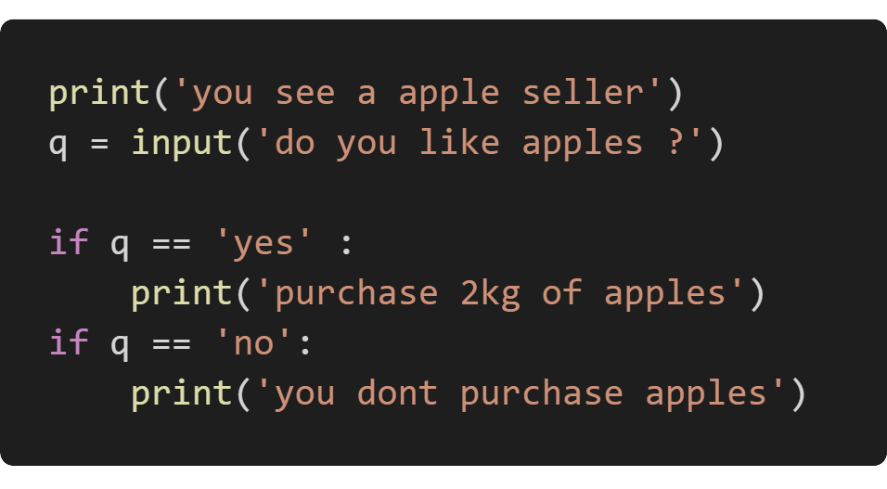
Building logic with if
Normal English
The python code
You see a apple seller
Do u like apples
If yes
you purchase 2 kg apples
If no
you don’t purchase apple

Slide 9
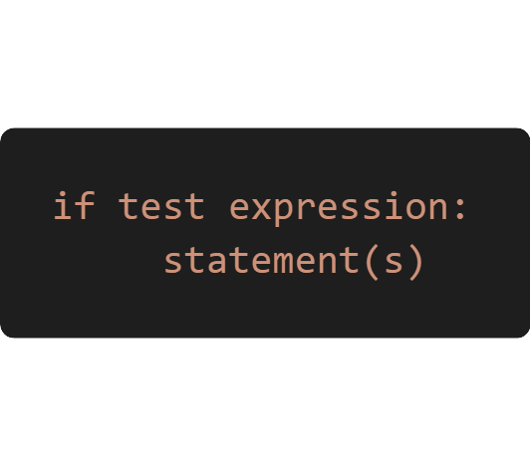
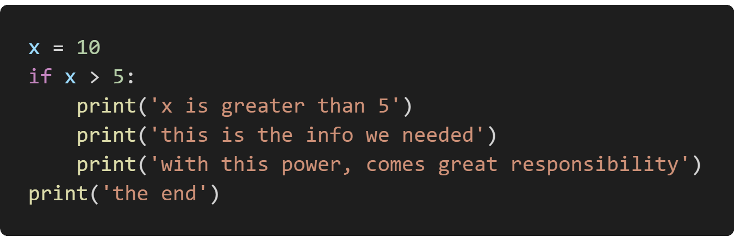
Building logic with if
Python if Statement Syntax
The program evaluates the test expression and will execute statement(s) only if the test expression is True
If the test expression is False, the statement(s) is not executed
Example code
In Python, the body of the if statement is indicated by the indentation. The body starts with an indentation and the first un-indented line marks the end
Python interprets non-zero values as True. While None and 0 are interpreted as False

Slide 10
Activity

Slide 11
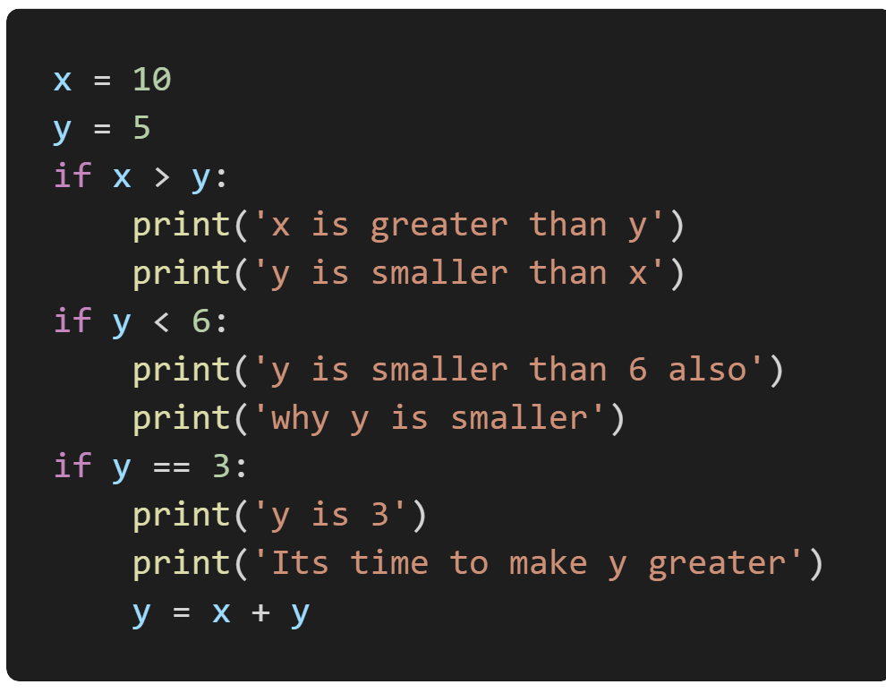
Activity 1: Change this code to normal English but with indentation
Look at this code
Write the English version of this code in copy
Let, x be 10
Let, y be 5
If x is bigger than y
X is greater than y
Y is greater than x
If y is smaller than 6
Y is smaller than 6 also
Why y is smaller ?
If y equal to 3
Y is 3
Its time to make y greater
Add value of x and y and keep it in y

Slide 12
lets code more examples

Slide 13
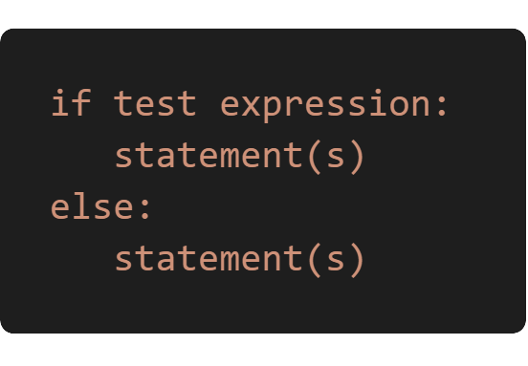
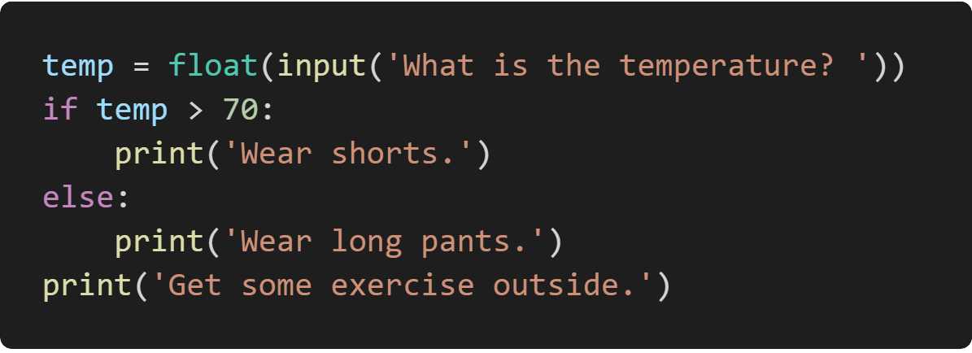
Building logic with if else
Python if else Statement Syntax
Example code
An else block can be combined with an if statement.
Important thing to remember
The else part contains the block of code that executes if the condition in the if expression is 0 or False.
The else keyword is an optional statement and there could be at most only one else statement following if.

Slide 14
Building logic with if-elif-else
Multiple expression
What is the score
What is the score
If score greater than or equal to 90
If score greater than or equal to 90
1
Your grade is A
1
Your grade is A
2
else
else if the score is greater than equals to 80
If the score is greater than equals to 80
2
3
Your grade is B
Your score is B
else if the score is greater than equals to 70
else
3
4
Your grade is C
5
If the score is greater than equals to 70
else if the score is greater than equals to 60
Your score is C
4
6
Your grade is D
else
else
7
If the score is greater than equals to 60
5
Your grade is F
Your score is D
8
else
Your score is F
If else complex version
If else easy combined version

Slide 15
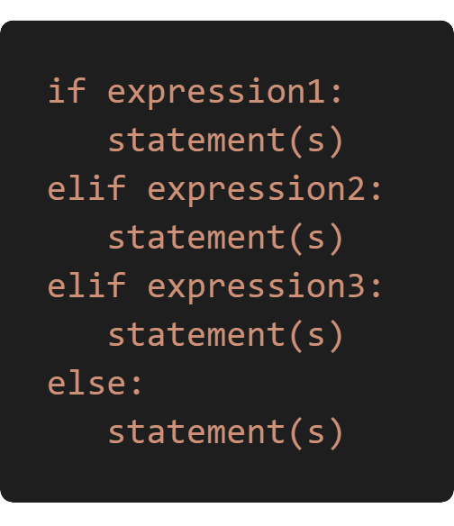
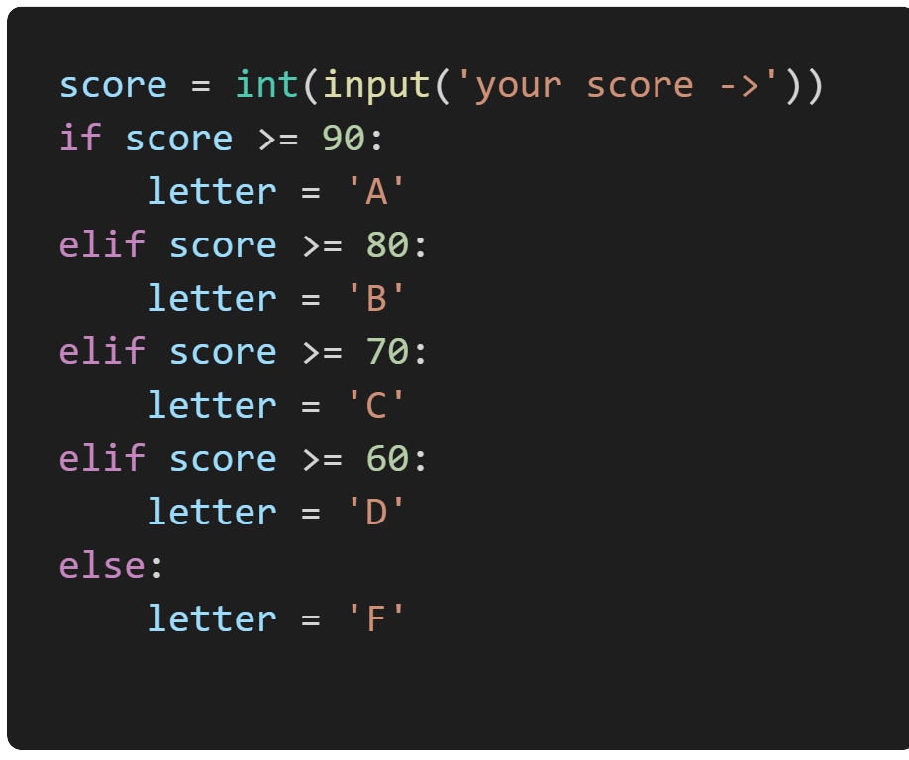
Building logic with if-elif-else
The elif Statement
The elif keyword allows us to check multiple expressions for True and execute a block of code as soon as one of the conditions evaluates to True
The elif block is optional. However, unlike else, for which there can be at most one statement, there can be an any number of elif statements following an if.
Important thing to remember
print(letter)

Slide 16
Coding time

Slide 17
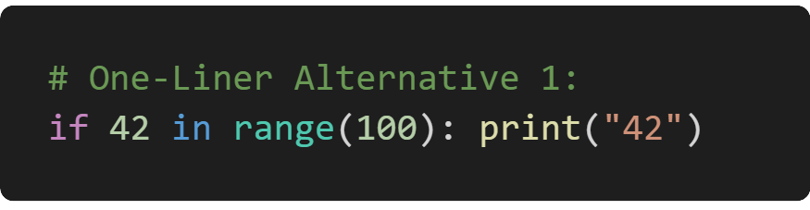
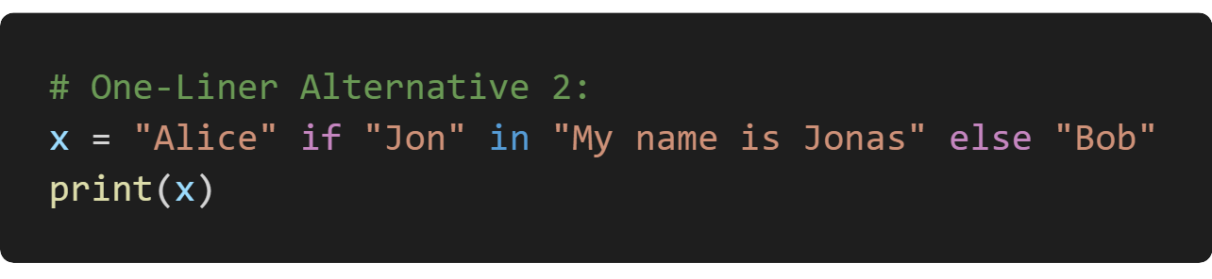
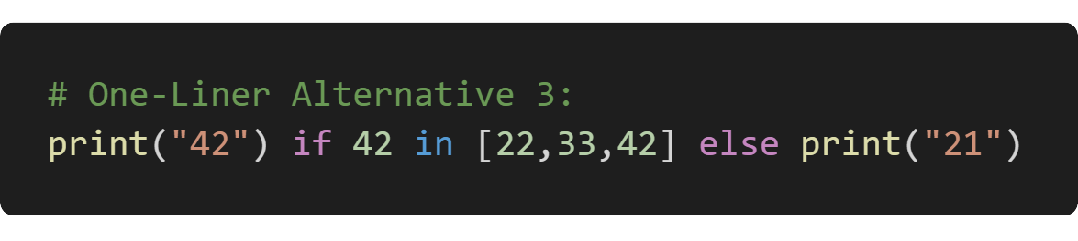
Compound statements
If-Then-Else in One Line
Write the if statement without else branch as a Python one-liner
Python is so powerful, you can even compress whole algorithms in a single line of code.
YES
Can you write conditional if-then-else statements in a single line of code?
If you want to set a variable, use the ternary operator
you can write most if statements in a single line of Python using any of the following methods
If you want to conditionally execute a function, still use the ternary operator

Slide 18
Let's code

Slide 19
THE END

